Slide 1

Basic Details of the Team and Problem Statement
Ministry/Organization Name/Student Innovation:
Ministry of Housing and Urban Affairs
PS Code:
SIH1512
Problem Statement Title:
Centralized Monitoring System for Street Light Fault Detection and Location Tracking
Team Name:
Wireless Warriors
Team Leader Name:
ALDRIN G
Institute Code (AISHE):
U-0460
Institute Name:
KARUNYA INSTITUTE OF TECHNOLOGY AND SCIENCES
Theme Name: SMART AUTOMATION

Slide 2
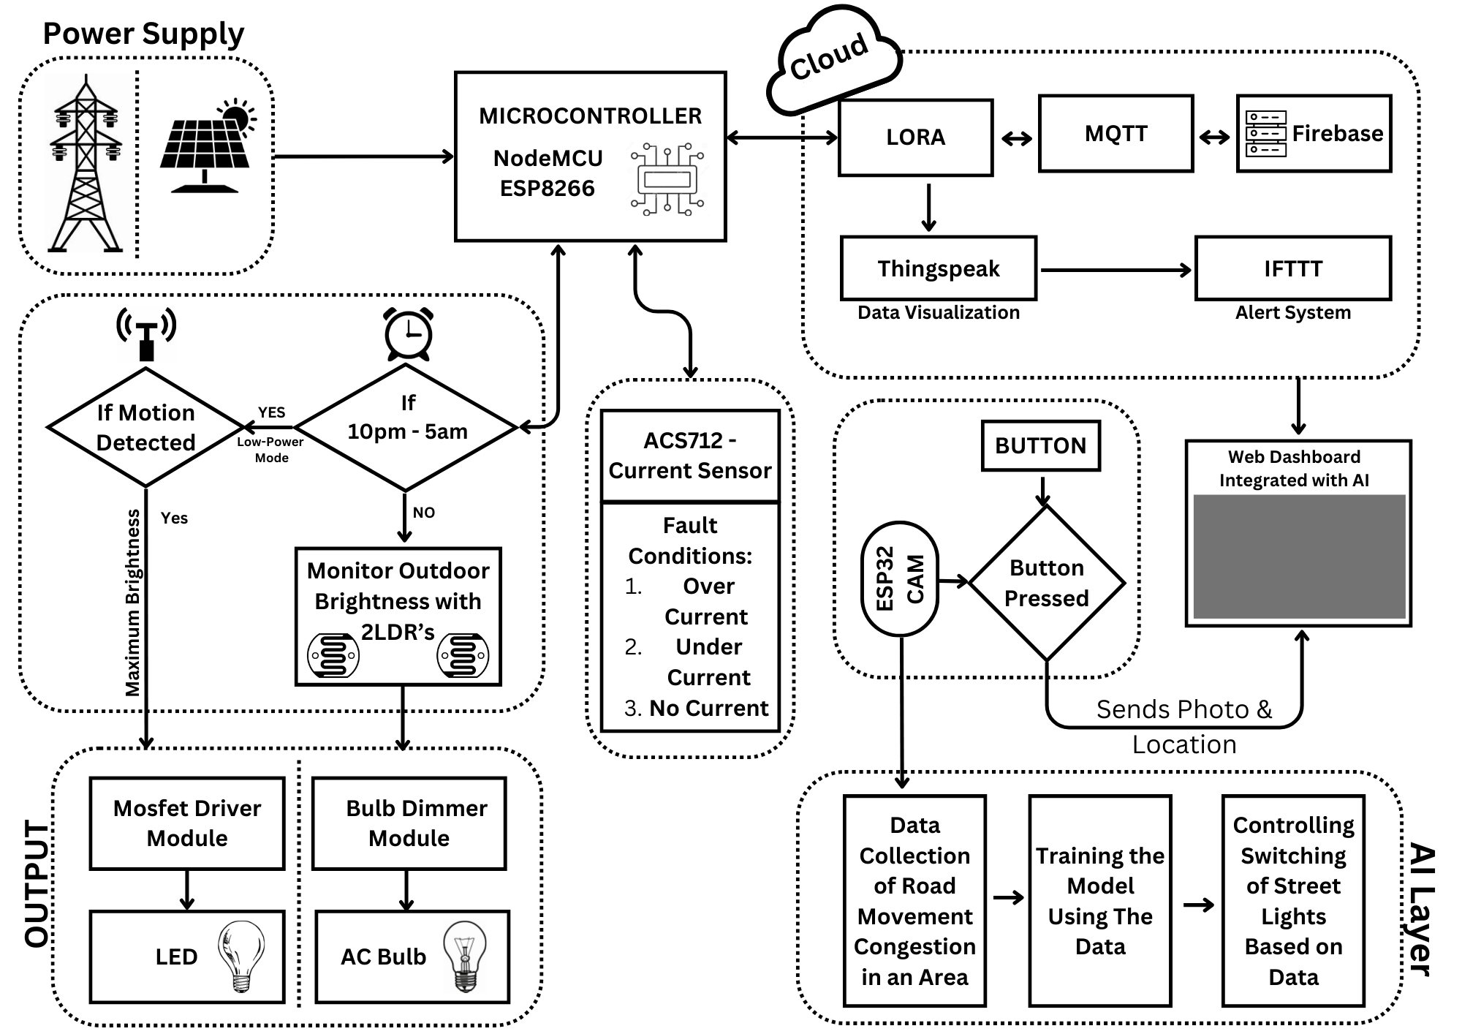






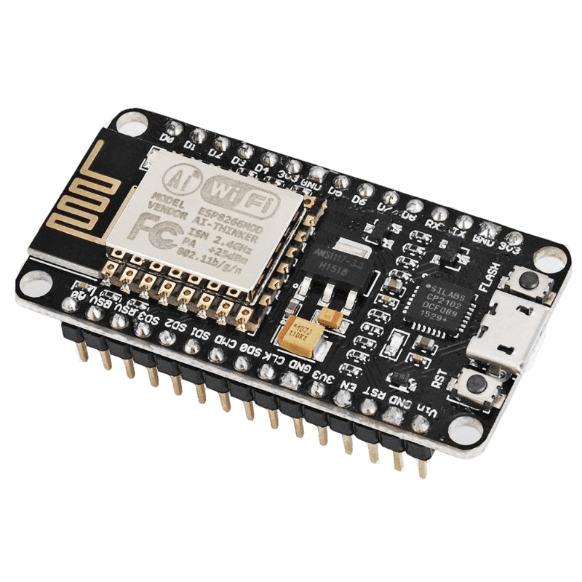



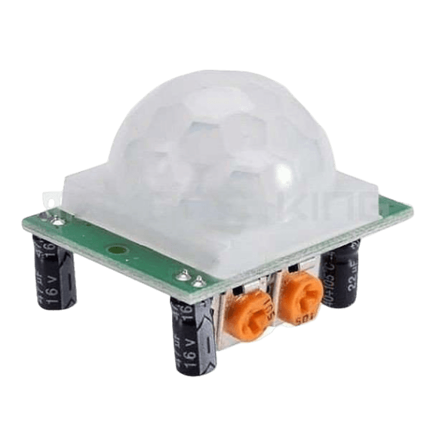



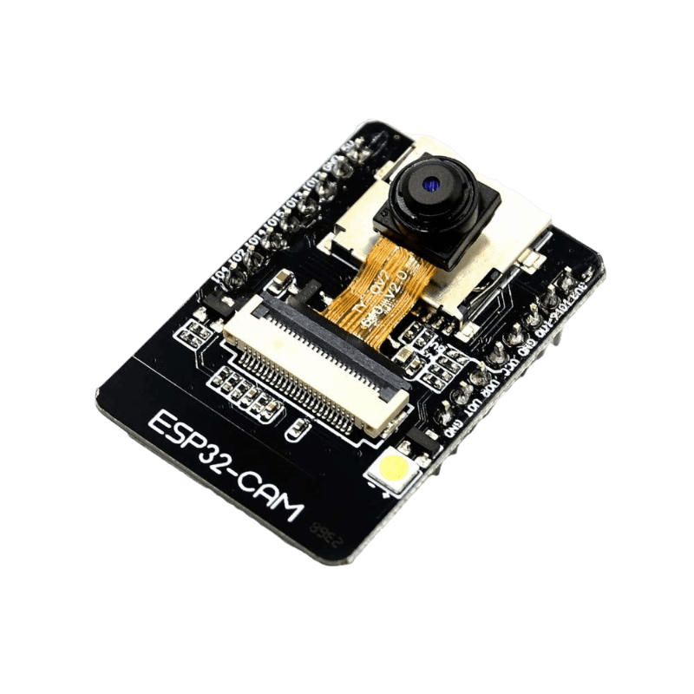
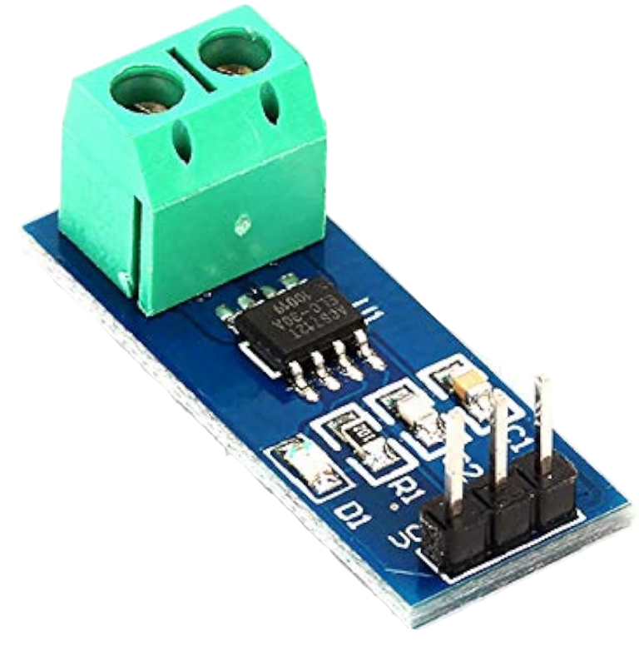


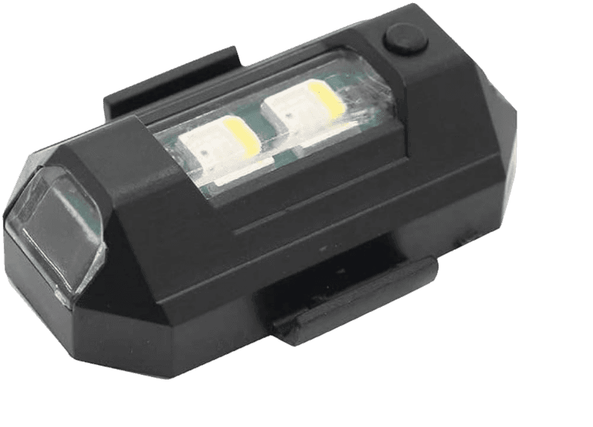
Idea/Approach Details
Idea/Solution:
Implementation of Interconnected Smart Street Lighting System using LoRaWAN technology and MQTT protocol with the following features.
This concept complies with Sustainable Development Goal 7:
"Affordable and clean energy" and also satisfies the objectives
of the national mission.
Using AI to control switching of streetlights based on road movement congestion.
Hybrid Solar/Grid-powered street lighting with
Power Consumption Monitoring and fault Detection.
Monitoring the Brightness of Sunlight by using two LDRs, and accurately
varying the brightness as per threshold limit and outdoor brightness.
Switching to Low-Power Mode from 10 pm to 5 am, during which the Lights glow
in minimum brightness and activates only in response to detected motion using
PIR Sensors.
When a malfunction is discovered, ThingSpeak is used to visualize data power usage,
and IFTTT is used to send alert notifications through mail, SMS, or mobile
phone along with the location.
Simple QR based Fault Registering System for local people in that area.
Add On - Unique SOS based emergency alert system(sends photo and location to the control system).
Add On - Alert LED’s indicating sharp turns in accident prone regions.
Technology stack:
NodeMCU
ESP8266
PIR Sensor
ESP32 CAM
ACS712-
Current Sensor
LDR
Alert LED

Slide 3
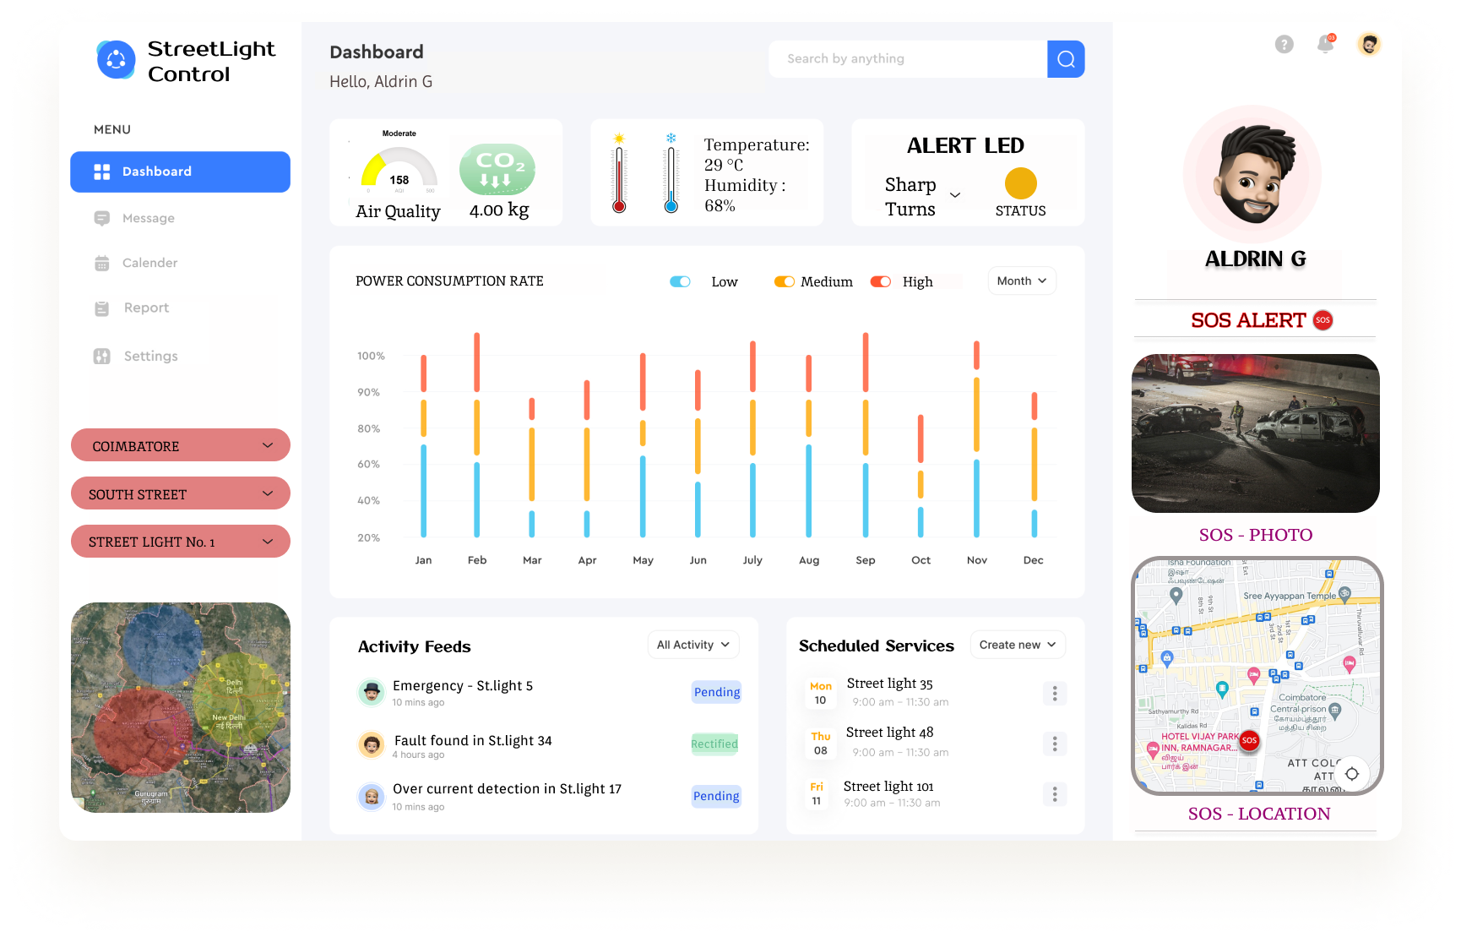
UX Web Dashboard
Power consumption rate
Selecting the street lights to view the details
Visuals from ESP32 cam and location of streetlight
LoRaWAN Gateway selection
Illustration of responses from various sensors
History of recent services

Slide 4
Idea/Approach Details
Use Cases
Show stopper
Best Solution for Lighting: In public places, Institutions and Highways
Energy Efficiency: Automatically adjusts brightness for energy savings and monitors power consumption.
Fault Detection: Notifies maintenance teams of bulb faults.
Emergency Response: Records and shares data, photos and video during emergencies.
Remote Control: Allows officials to control lights via a mobile app.
Traffic Management: Indicates sharp turns and accident-prone zones.
Data Analytics: Visualizes real-time data for informed decisions.
Renewable Energy: Integrates solar power for green energy.
Network Reliability: Frequent network disruptions hinder data transmission.
Power Supply: Power outages without backup solutions affect system operation.
Sensor Accuracy and Maintenance: Sensor malfunction leads to inaccurate data.
Mobile App and Cloud Services: Service outages disrupt app functionality.
Security Vulnerabilities: Vulnerabilities compromise data and system integrity.
Hardware Reliability: Frequent hardware failures disrupt the system.

Slide 5
Team Member Details
Team Leader Name: ALDRIN G
Branch (Btech/Mtech/PhD etc): Btech Stream (ECE, CSE etc): ECE Year (I,II,III,IV): II
Team Member 1 Name: RAJATH M V
Branch (Btech/Mtech/PhD etc): Btech Stream (ECE, CSE etc): ECE Year (I,II,III,IV): II
Team Member 2 Name: SAMSON J
Branch (Btech/Mtech/PhD etc): Btech Stream (ECE, CSE etc): ECE Year (I,II,III,IV): II
Team Member 3 Name: SHARON ROSE J
Branch (Btech/Mtech/PhD etc): Btech Stream (ECE, CSE etc): ECE Year (I,II,III,IV): II
Team Member 4 Name: DANIEL DENCIL J
Branch (Btech/Mtech/PhD etc): Btech Stream (ECE, CSE etc): ECE Year (I,II,III,IV): II
Team Member 5 Name: ANNIE JENNITA V J
Branch (Btech/Mtech/PhD etc): Btech Stream (ECE, CSE etc): ECE Year (I,II,III,IV): II
Team Mentor 1 Name: Dr. H. VICTOR DU JOHN
Category (Academic/Industry): Academic Expertise (AI/ML/Blockchain etc): IoT Domain Experience (in years): 11
Team Mentor 2 Name: Dr. NARAIN PONRAJ. D
Category (Academic/Industry): Academic Expertise (AI/ML/Blockchain etc): AI & ML Domain Experience (in years): 17

